Slide 1
Gaming the System of Gaming: The Expected and Unexpected Effects of Probability
Math Circles 2019

Slide 2
Games and Probability
Some games do not depend on luck.
Chess, Tic-tac-toe, Connect Four
Some games depend entirely on luck.
Chutes and Ladders, Candyland, Rolling Dice
Most games depend on some combination of skill and luck.
Games can be fair or unfair to the players depending on how the luck is distributed. We can use probability to figure whether a game is fair.

Slide 3
How Probability Began
Two of the first people to study probability using math were Pierre de Fermat and Blaise Pascal.
Game 1: The Problem of Points
We’ll use rock-paper-scissors

Slide 4
Game 1 Rules
Everyone should find a partner to play with.
We’ll pretend that each player bets $5 that they are going to win. The winner gets to keep all of the $10.
Winning a game of rock-paper-scissors earns you a point. The first to ten points wins.
Make sure you agree on the timing before you start.
Whenever you win a game, make a mark on your game sheet.
IMPORTANT: Once you reach 10 points, raise your hand.

Slide 5
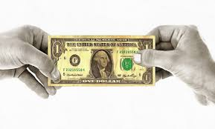
Interruption
Your game was interrupted before you could complete it, and you can no longer finish it.
Question: How should the $10 be split up fairly between the two players?

Slide 6
Game 1 Solution
Imagine one player has 9 points and the other has 8 points.
How many different ways could the future of the game have gone?
1. Player 1 gets a point and wins. 50% Chance
2. Player 2 gets a point, and the game is tied 9-9. 50% Chance
2a. Player 1 gets a point and wins. 50% of 50% chance, 25% chance
2b. Player 2 gets a point and wins. 50% of 50% chance, 25% chance
So 75% of the time, Player 1 wins. So 75% percent of the $10 should go to Player 1. Player 1 gets $7.50 and Player 2 gets $2.50
We can apply this same logic to other point setups.

Slide 7
Knowledge and Probability
When flipping a fair coin, how likely is it to get 10 heads in a row?
1/2 of the time we get heads. Doing this 10 times is 1/1024.
Extremely unlikely!
When flipping a fair coin, if we’ve gotten 9 heads in a row, how likely is it to get 10 heads in a row?
1/2 of the time we get heads. So it’ll happen 1/2 of the time.
Not bad!

Slide 8
Knowledge and Probability
Why does the probability change?
When we start with 0 heads, we have no knowledge about the coin flips up to that point.
When we start with 9 heads, we have a lot of knowledge about the coin flips up to that point.
Our knowledge changes the probability!
Gambler’s Fallacy
Or maybe not…?

Slide 9
Game 2: Monty Hall Problem
This is a variation of a game that appeared in the game show Let’s Make a Deal, hosted by Monty Hall.
There are three doors. Behind one door is a brand new car. Behind the other two doors is a goat (and nobody wants a goat)
The goal is to pick the right door so that the player gets the car instead of the goat.

Slide 10
Game 2 Rules
The player picks a door.
Monty Hall opens one of the doors that has a goat behind it.
The player is then allowed to either keep their choice or switch to the other door.
The doors are all opened, and the player gets whatever is behind their chosen door.

Slide 11
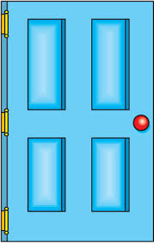
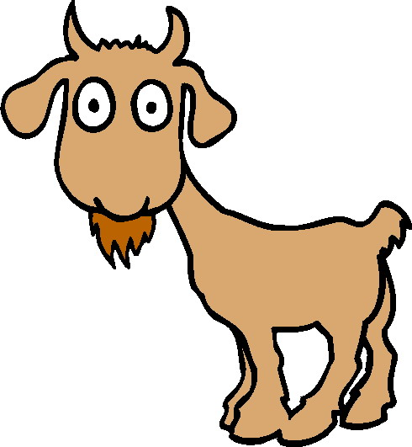
Game 2
Ten volunteers to play the game.
Those who aren’t volunteers should play the game on their game sheets. Once the person playing has chosen a door and one of the goats is revealed, mark down whether you decided to keep the chosen door or switch to the other door. Then mark down whether you won or lost.

Slide 12
Game 2: Fair?
Question: Which choice is better, to switch or to stay after the goat is revealed? Or are both equally good choices?
Solution: Switching gives you a 2/3 chance of winning!

Slide 13
Game 2: Solution
Say we choose Door 1. There are three ways the prizes could be set.
The Key: Opening a door increases our knowledge about the game, changing the probability.

Slide 14
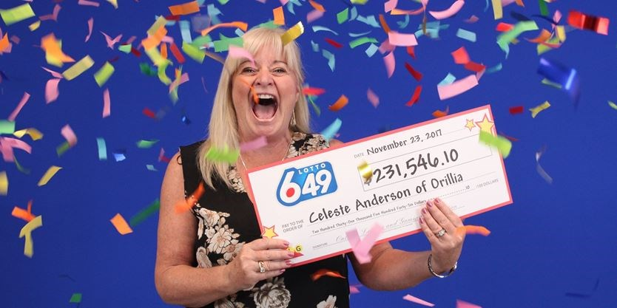
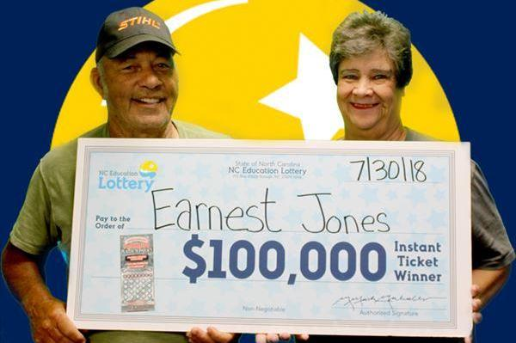
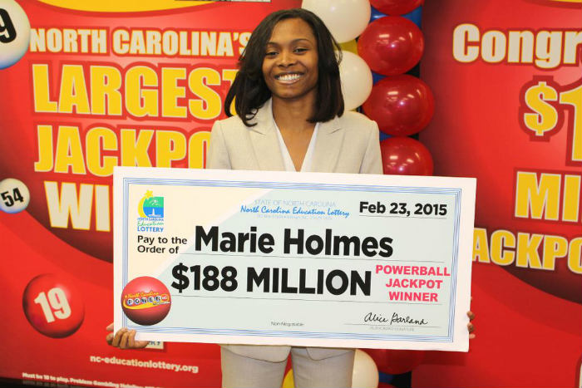
The Lottery
Winning the lottery is a dream for a lot of people.

Slide 15
Game 3: Lottery
Our game will be based on a recent game of the Colorado Lotto.
Pick 6 different numbers from 1 to 42.
The order of the numbers doesn’t matter.
Your lottery ticket costs $1.
Don’t change the numbers after writing them! (It will mess up the math.)
Match 6 numbers: $3,985,265
Match 5 numbers: $566
Match 4 numbers: $44
Match 3 numbers: $3

Slide 16
Game 3: Lottery
And the winning numbers are….
22 34 7 5 11 8

Slide 17
Game 3: Lottery
Who won? Who is always going to win?
How can the lottery organizers make sure that they will always come out on top?
Since so many people play the lottery, they just need to make sure that they pay out less than they get from selling tickets.
They do this by calculating what each ticket is worth in “expected value.”

Slide 18
Expected Value
We calculate the expected value of the ticket by looking at how likely it is to win versus how much money will be won.
Chance of getting all 6 numbers: 1 in 5,245,786.
Payout for getting all 6 numbers: $3,985,265.
Comparison: $\$3,985,265 ×\frac{1}{5,245,786}=0.7597$“dollars per chance.”

Slide 19
Expected Value
We do the same thing for the other three prizes.
Expected Value =$\left(\$3,985,786 ×\frac{1}{5,245,265}\right)+\left(\$566 ×\frac{37}{5,245,265}\right)+\left(\$44 ×\frac{703}{5,245,265}\right)+\left(\$3 ×\frac{9139}{5,245,265}\right)=\$0.775$
What does this mean?

Slide 20
Game 3 Solution
A lottery ticket costs $1. However, our calculation shows that a single lottery ticket is worth 77.5 cents. This means we’re paying more for a ticket than it’s worth, on average.
Since lots of people buy lottery tickets, the people running the lottery will on average get 22.5 cents for every ticket sold. That is, they’ll always win money!
On the other hand, someone who buys lots of lottery tickets will lose 22.5 cents for every ticket bought, on average.
What about different jackpot sizes?

Slide 21
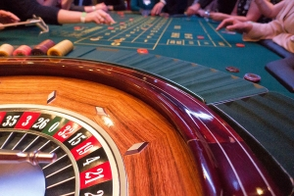
Other Unfair Tricks
Casinos and online gambling sites use mathematics to purposely make their games unfair for the player.
They make sure the chance of winning is low enough compared to the prize money so that the expected value is less than the player pays.

Slide 22
Other Unfair Tricks
But other games of chance are designed this way too.
Example: Loot boxes in games. The publisher wants to keep earning money, so they design the probabilities so that, on average, you never get loot boxes worth more than you pay.

Slide 23
Conclusion: Your Choice
Whether you play games of chance is up to you.
However, you should be aware of the mathematics behind these purchases.
If the fun of the games is worth enough to you to balance the loss, then you may still choose to play.
However, the lottery and casinos are not worth it.

Slide 24
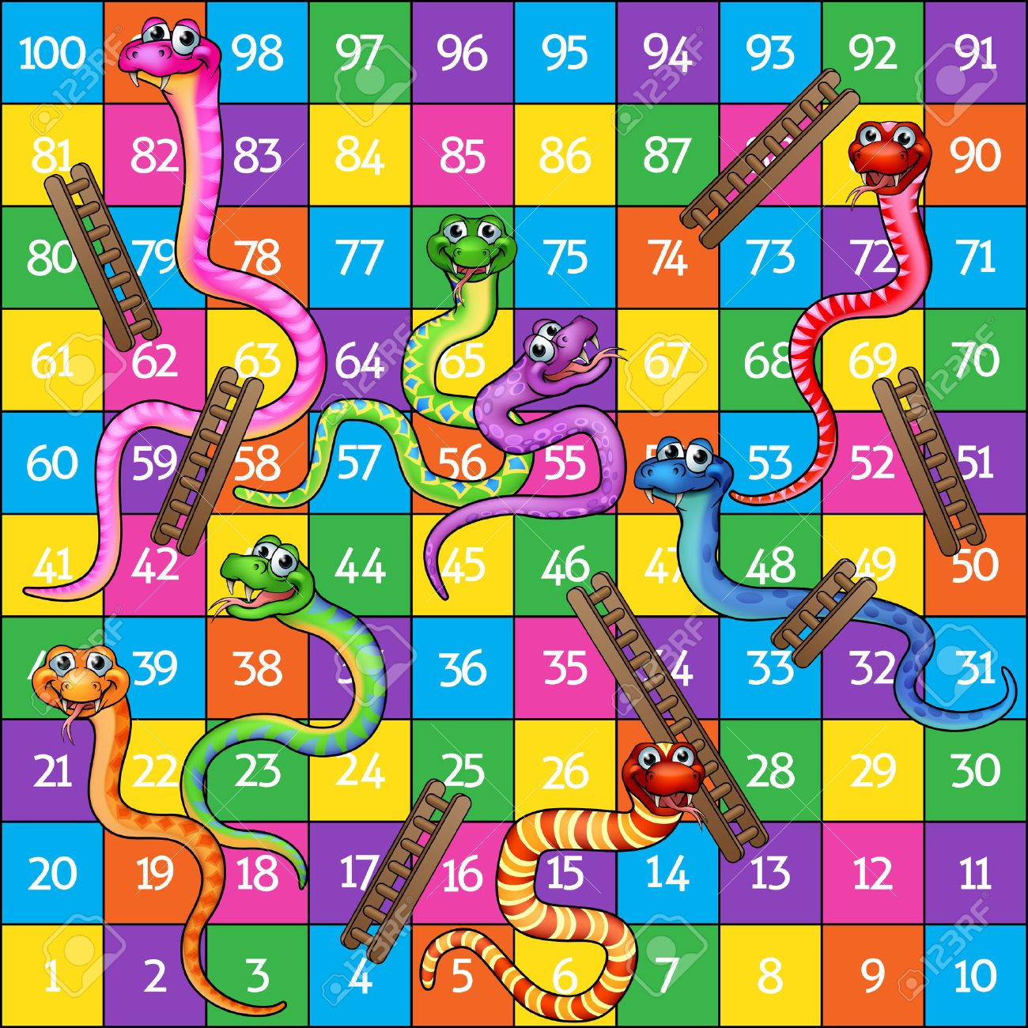
Extra Activity: Snakes and Ladders

